Slide 1
Control Flow – Loops
COS 1020 C++ Programming
AUBG COS Department
Based on chapter 5 – problem solving, abstraction and design using C++, Friedman & Koffman

Slide 2
Lecture Contents
5.1 Counting Loops and the while Statement
5.2 Accumulating a Sum or Product in a Loop
5.3 The for Statement
5.5 Loop Design and Loop Patterns
5.6 The do-while Statement
5.7 Review of Loop Forms
5.8 Nested Loops
5.9 Debugging and Testing Programs

Slide 3
Control Structures
Sequence
Selection
Repetition
  Loop – a control structure that repeats a set of statements in a program
  Loop body – the statements that are repeated in the loop

Slide 4
When are Loops Needed?
Basically any program that repeats steps to solve a problem needs a loop.
For example, imagine you have to write a program to read a set of numbers from the user.
  If you know their count, you can write individual input statements. The program will grow if you have to read 100 or even 1000 numbers.
  What if you do not know how many numbers you have to read in advance?

Slide 5
Counting Loops and the while Statement
A counter-controlled loop
  A loop whose repetition is managed by a loop control variable whose value represents a count
Loop control variable
  A variable that is used to regulate how many times a loop should be executed
Counting Loop Pseudocode
Set loop control variable to 0
while loop control variable < final value
statements;
…
Increase loop control variable by 1

Slide 6
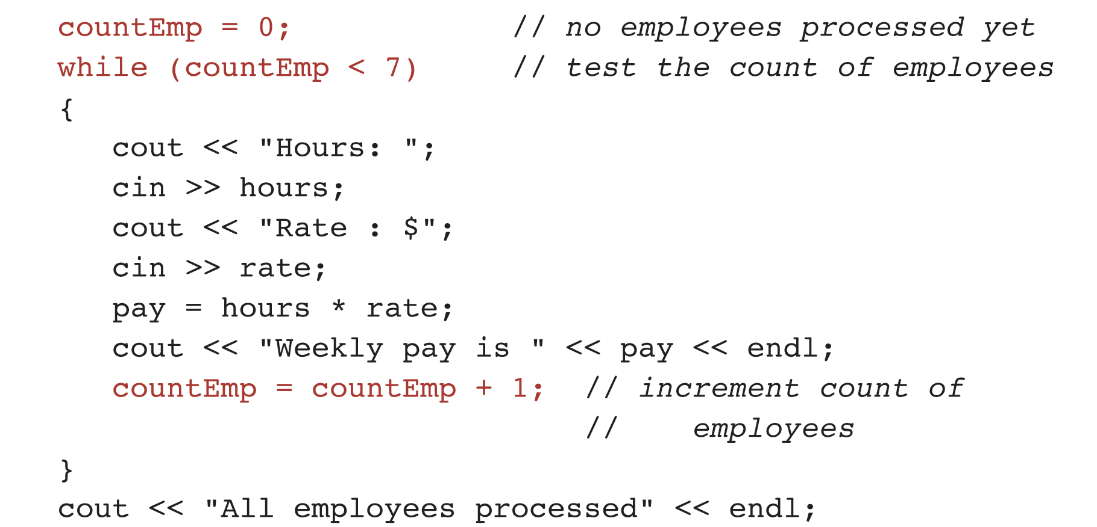
Example: Compute the Gross Salary for Seven Employees

Slide 7
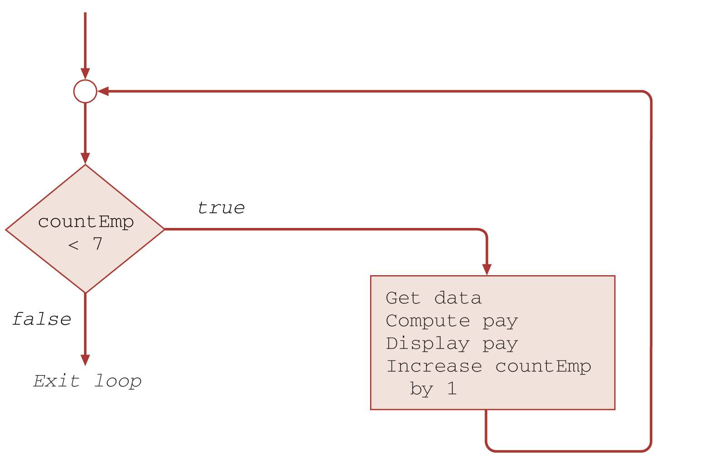
Flowchart for a while Loop

Slide 8
Example Explanation
The while Loop Body
  Compound Statement
  Reads the employee pay data
  Computes and displays the employee’s pay
After 7 employees are processed (input, calculated and displayed), repetition stops and the statement after the loop body executes:
  Displays the message "All employees processed."

Slide 9
Example Explanation (continued)
The three lines marked with a star control the repetition process:
  countEmp = 0;
    Sets the initial value of the counter variable to 0, representing the number of employees processed so far
  (countEmp < 7) – loop repetition condition
    If true, statements in the loop body are executed
    If false, loop body is skipped and control is passed to the line following the loop body

Slide 10
Example Explanation (continued)
  countEmp = countEmp + 1;
    Increments the current value of the counter variable by 1
After executing the last statement of the loop body
  Control returns to the beginning of the while
  The condition is reevaluated
  When true, the loop body is repeated
  When false, the loop is exited

Slide 11
while Statement Syntax
General form:
  while (loop repetition condition)
  statement;
Example:
// print 10 stars on the screen
int countStar = 0, numStars = 10;
while (countStar < numStars) {
cout << "*";
countStar = countStar + 1;
}

Slide 12
Loop Control Notes
For a loop to execute properly, its control variable must be:
  Initialized
  Tested
  Updated
If not properly updated, an infinite loop can result
If the loop repetition condition evaluates to false the first time it’s tested, the loop body statements are never executed.

Slide 13
Accumulating a Sum or Product in a Loop
Loops often accumulate a sum or product by repeating an addition or multiplication operation.

Slide 14
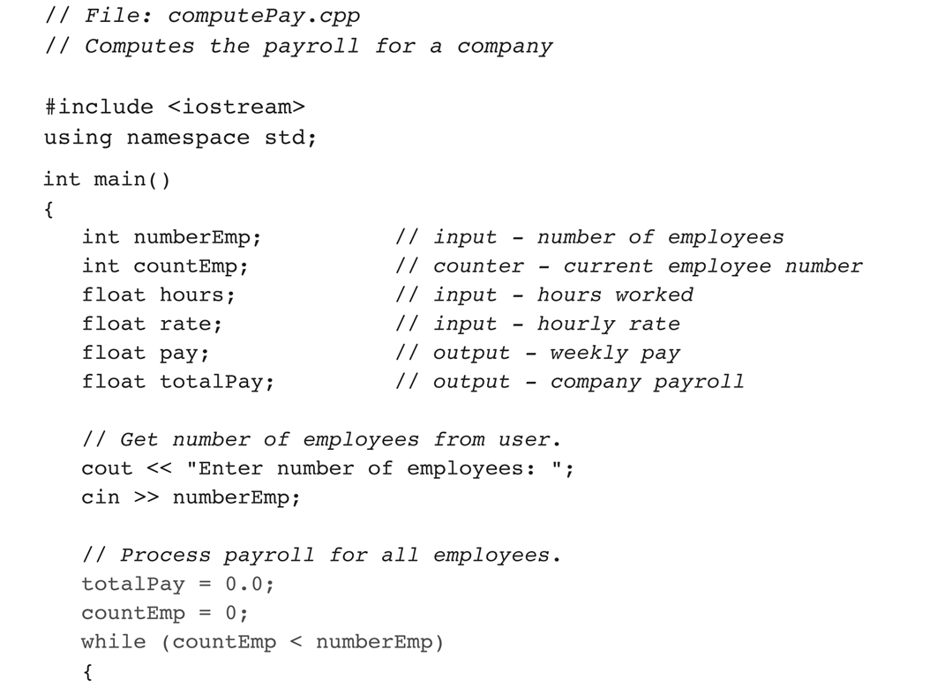
Program to Compute Company Payroll

Slide 15
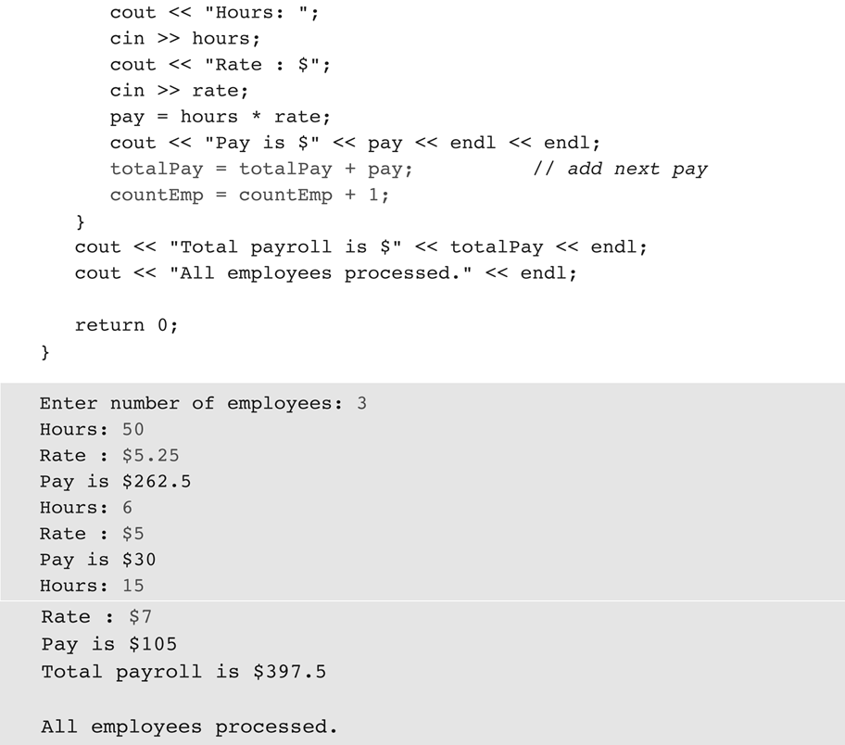

Slide 16
Example – Compute Payroll
Initialization statements
totalPay = 0.0; // pay accumulator
countEmp = 0; // loop control variable that
// counts number of
// employees processed
Accumulation
  totalPay = totalPay + pay; // add next pay
Incrementation
  countEmp = countEmp + 1; // increment by 1

Slide 17
Writing General Loops
Loop condition to process exactly 7 employees
  while (countEmp < 7)
To implement a loop that processes an unknown number of employees, that number of employees must be read into a variable numberEmp before the while statement executes
  while (countEmp < numberEmp)

Slide 18
Multiplying a List of Numbers
int item;
int product = 1;
while (product < 10000)
{
cout << product << endl; // display product
cout << "Enter data item: ";
cin >> item;
product = product * item; // update product
}
cout << "Product: " << product << endl;

Slide 19
Conditional Loop
Used when you cannot determine in advance how many loop repetitions are needed.
The number of repetitions is controlled by a condition that must remain true in order for the loop to continue.
1. Initialize the loop control variable
2. While a condition involving the loop control variable is true
  3. Continue processing
  4. Update the loop control variable

Slide 20
Compound Assignment Operators
Assignments to modify a single variable:
  variable = variable op expression;
Those can also be rewritten as:
  variable op = expression;
Examples:
countEmp = countEmp + 1; countEmp += 1;
product = product * i; product *= i;
time = time – x; time -= x;

Slide 21
The for Statement
Especially useful for counting loops
General form:
  for (initialization expression;
  loop repetition condition;
  update expression)
  statement;
Example:
for (countStar = 0; countStar < N; countStar += 1)
cout << "*";

Slide 22
The for Statement (continued)
None of initialization expression, loop condition and update expression is mandatory:
  for (;;)
  statement;
Example:
countStar = 0, N = 10;
for (;;countStar += 1) {
if (countStar > N) break;
cout << "*";
}

Slide 23
The for Statement (continued)
While
for
      int countStar = 0, N = 10;
      while(countStar < N) {
      cout << “*”;
      countStar += 1;
      }
for (int countStar = 0, N=10;
countStar < N;
countStar += 1) {
cout << "*";
}

Slide 24
Will This Print the Same Thing?
While
for
      int i = 0, N = 10;
      while(i < N) {
      i += 1;
      cout << i << endl;
      }
for (int i = 0, N=10;
i < N;
i += 1) {
cout << i << endl;
}

Slide 25
The for Statement (continued)
What are the following examples doing? How many times they will be executed?
for (int i=0;;i+= 1) {
cout << "*";
if (i >= 0) break;
}
for (;;) {
cout << "*";
}

Slide 26
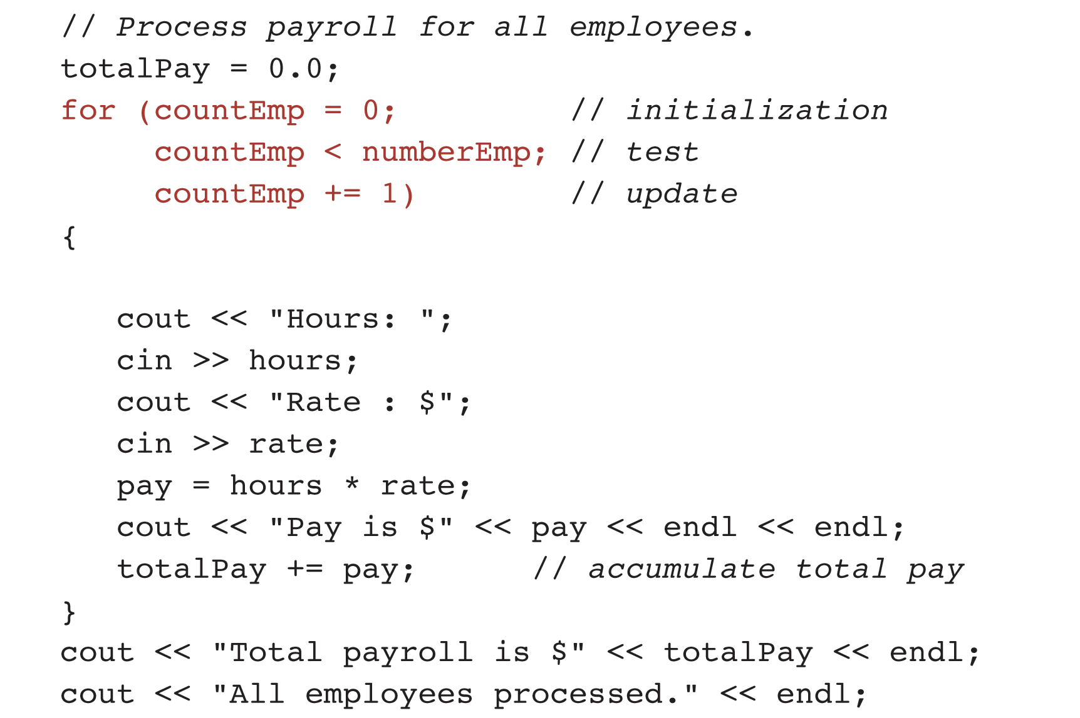
Using a for statement in a counting loop

Slide 27
for Loop Interpretation
Initialization expression is executed
The loop repetition condition is tested
  If true, the loop body is executed and the update expression is evaluated. Then the loop repetition condition is retested and the body repeated as long as the loop repetition condition is true.
  When false, the for loop exits and the program continues with the first statement after its body.
NOTE: Use integer values for loop counting variables.

Slide 28
Increment and Decrement Operators
A statement that increments or decrements a single variable by one:
  counter = counter + 1
Can be rewritten as:
  counter++ or ++counter
The increment operator ++ takes a single variable as its operand and when applied on that variable, increments its value by one
The decrement operator -- decrements a variable’s value by one

Slide 29
Increment and Decrement Operators (continued)
Used to update a loop control variable
The value of the expression in which the ++ or -- operator is used depends on its position:
  Postfix operator:
m = 3;
n = m++; // n is 3, m is 4
  Prefix operator:
m = 3;
n = ++m; // n is 4, m is 4

Slide 30
Program to Computer Factorial
#include <iostream>
using namespace std;
int main() {
int n;
int product = 1;
cout << "Enter a number: ";
cin >> n;
for (int i = n; i > 1; i--) {
product = product * i;
}
cout << "Factorial is: " << product << endl;
return 0;
}

Slide 31
Localized Declarations of Variables
A loop control variable declared in the initialization step of a for loop is said to have local scope
  for (int i = n; i > 1; i--)
It is declared at the point of first reference (initialization step) and can only be referenced from the loop header (condition and update expressions) and the loop body.
After the loop exists, the variable is destroyed.

Slide 32
Loop Design and Loop Patterns
Many programs have loops that read data in their body
Often it is not know how many times the loop should run when it begins execution
Sentinel-controlled Loops:
  1. Read the first data item
  2. while the sentinel value has not been read
  3. Process the data item
  4. Read the next data item

Slide 33
Sentinel-controlled Loops
A sentinel is a specific predetermined value used to terminate one type of event-controlled loop
It is the same type as the other data being processed
It is outside the range of valid values for the data

Slide 34
Example: Sum Exam Scores
const int SENTINEL = 0;
int score, sum = 0;
cout << "Enter a number (0 to exit): ";
cin >> score;
while (score != SENTINEL) {
sum += score;
cout << "Enter a number (0 to exit): ";
cin >> score;
}
cout << "The sum is: " << sum << endl;

Slide 35
Flag-controlled Loops
Type bool variables are also called flags
A flag-controlled loop is a loop whose repetition condition is a boolean variable
Algorithm:
  1. Set the flag to true
  2. While the flag is true
  3. Perform some action
  4. Set the flag to false if the loop should stop

Slide 36
Example: Flag-controlled Loop
// NOTE: reads the input character by character and outputs
// the first digit character encountered
char digitChar;
bool digitRead = false; // initial value of flag is false
while (!digitRead) {
cin >> digitChar;
// checks whether the character (type char) is a digit
digitRead = ('0' <= digitChar) && ('9' >= digitChar);
}
cout << "First digit: " << digitChar << endl;

Slide 37
The do-while Statement
A while loop can be executed zero or more times
A do-while loop is executed at least once
General form:
  do
  {
  statement;
  } while (expression);
Notice that the iterative part executes before the loop-test at the end

Slide 38
Data-validation Loop
A do-while statement can be used to implement a data-validation loop – a loop that continues to prompt and read data from the user until a valid item is entered.
Example:
do {
cout << "Enter number of employees: ";
cin >> numEmp;
} while (numEmp < 0);

Slide 39
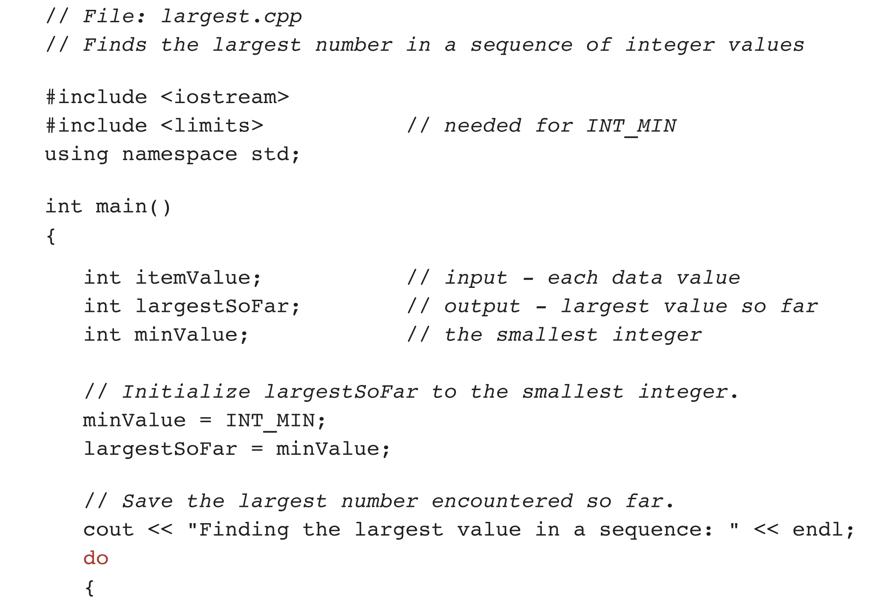
Example: Finding the Largest Value

Slide 40
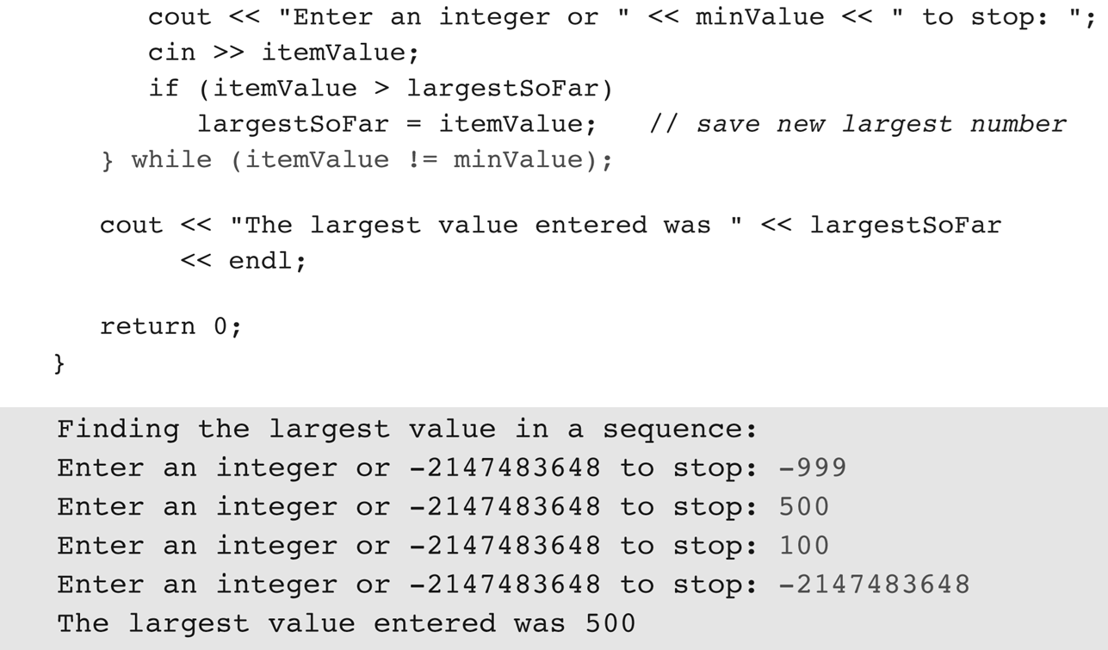
Example: Finding the Largest Value (continued)

Slide 41
Review of Loop Forms
while
  Most commonly used when repetition is not counter controlled
  The loop condition test is done before each loop repetition
  The loop body may not be executed at all
Example:
count = startValue;
while (count < maxValue) {
...
count++;
}

Slide 42
Review of Loop Forms (continued)
for
  Used to implement a counting loop – i.e. when the number of repetitions is known in advance
  Also convenient for other loops with simple initialization and update steps
  The condition test precedes the execution of the loop body
  The loop body may not be executed at all
Example:
for (i = 0; i < 10; i++) {
cout << '*';
}

Slide 43
Review of Loop Forms (continued)
do-while
  Convenient when at least one repetition of the loop body is required
  The condition test is performed after the loop body is executed
  The loop body is executed at least once
Example:
char answ = 'y';
do {
...
cout << "Continue?";
cin >> answ;
} while (answ == 'y');

Slide 44
Nested Loops
Similar to if statements, loops can be nested
Nested loops consist of an outer loop with one or more inner loops
Each time the outer loop is repeated, the inner loops are reentered, loop control components reevaluated and required iterations performed.

Slide 45
Example: Displaying the Multiplication Table
#include <iostream>
#include <iomanip> // needed for setw()
using namespace std;
int main()
{
for (int row = 1; row < 10; row++) {
cout << setw(3) << row << ' ';
for (int col = 1; col <= 10; col++) {
cout << setw(3) << row * col;
}
cout << endl;
}
return 0;
}

Slide 46
Example: Displaying the Multiplication Table (continue)
Row | Column
1 | 1
1 | 2
… | …
1 | 10
2 | 1
2 | 2
… | …

Slide 47
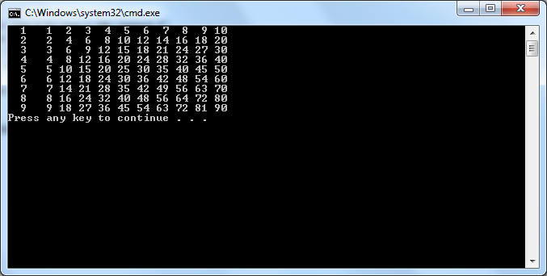
Example Output: Displaying the Multiplication Table

Slide 48
Debugging and Testing Programs
Debugging is the process of locating a logical error – i.e. an error that causes a program to produce wrong results
Often the error is not obvious and requires a considerable amount of time to locate
Modern Integrated Development Environments (IDEs) include features to help you debug a program while it is executing
If a debugger cannot be used, you can insert extra diagnostic output statements to display intermediate results at critical points in your program

Slide 49
Debugging Without a Debugger
Insert diagnostic output statements:
  At locations where you suspect things are going wrong or other critical points in the code:
    Beginning and end of functions
    After complex calculations
  To display intermediate results, e.g. variables affected by each major algorithm step
After debugging is complete, remove or “comment out” the diagnostic statements

Slide 50
Testing
After all errors have been cleared, thorough testing should be performed
Check all paths through decision statements and the number of iterations for loops
Make enough test runs to verify that the program works properly for representative samples of all possible data combinations

Slide 51
Questions?
Q & A

